Slide 1
Wall Switch Sensors

Slide 2
Wall Switch Sensors
Application
Easiest method of adding occupancy detection
Replaces existing toggle switch without additional wiring
30 to 50% Savings
Lowest cost approach for individual room control
Examples
PIR :
Private Offices
Copy Rooms
Closets
Private Restrooms
Hallway w/ 3-way Switching
Other small enclosed spaces
Dual Tech:
Private Offices w/ Obstructions
Restrooms w/ Stalls
2-Pole:
Restrooms w/ Light & Fan
Offices wired for Bi-Level (Inboard/Outboard) Lighting

Slide 3
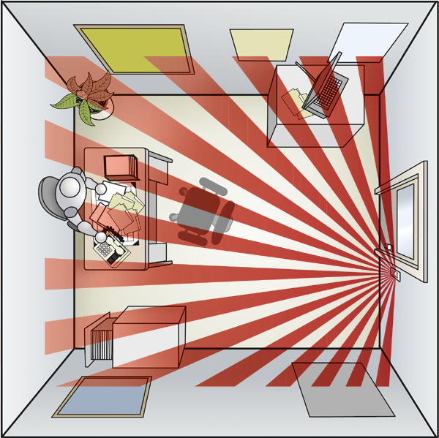
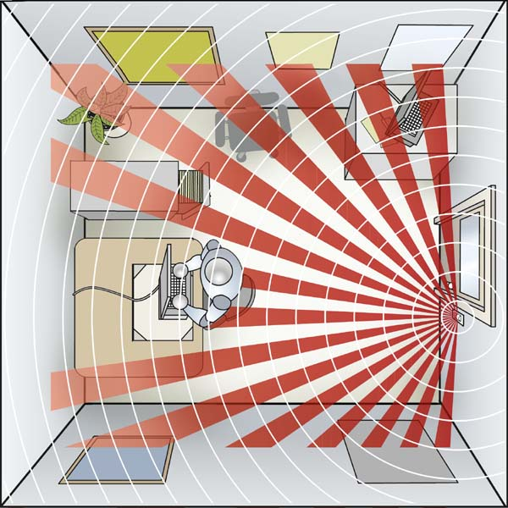
Applications: Wall Switch Sensors
Private Office w/o Obstructions
(PIR: WSX)
Private Office w/ Obstructions or Occupant w/ Back to Sensor
(Dual Tech: WSX PDT)

Slide 4
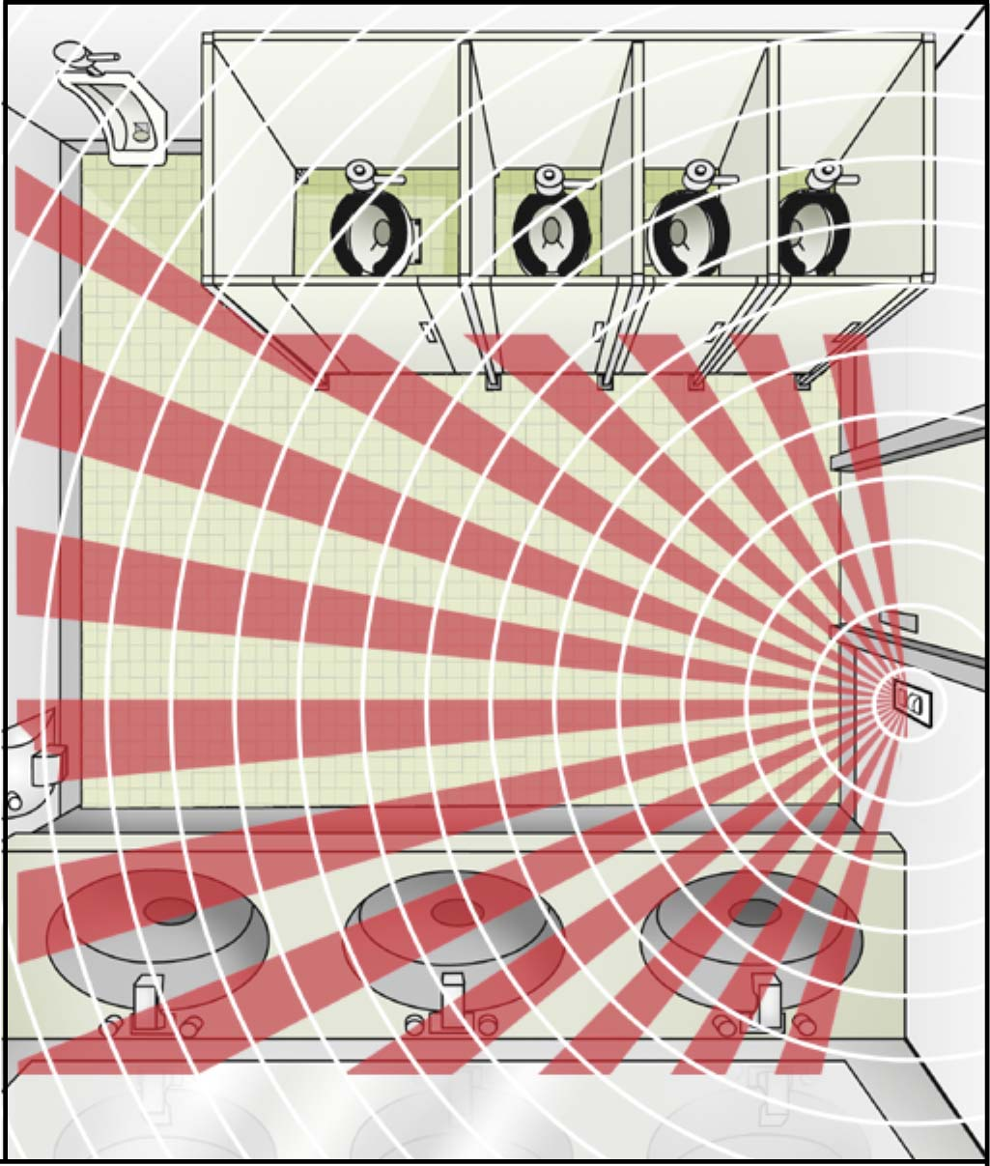
Applications: Wall Switch Sensors
Restroom with Stalls
(Dual Tech: WSX PDT)
Private Office w/o Obstructions
(PIR)

Slide 5
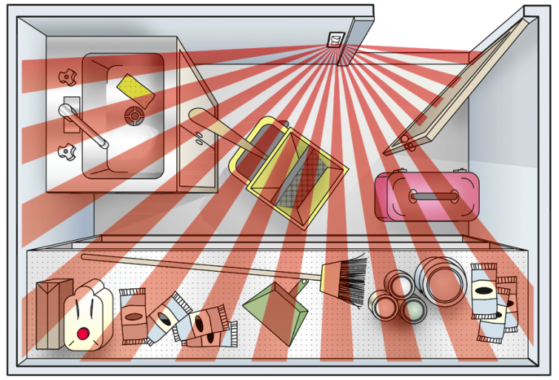
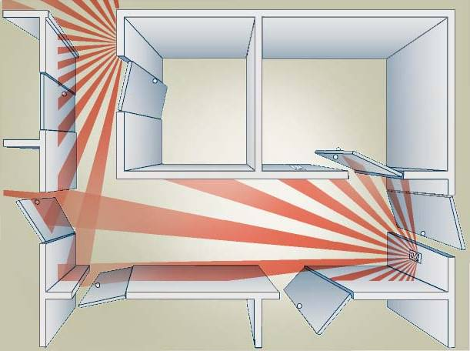
Applications: Wall Switch Sensors
Closet & Storage (PIR: WSX)
Better payback than changing incandescent to a fluorescent!
Reduces light usage to less than 500 hrs per year
Convenience – No fumbling in the dark
Parallel Switching from two locations (PIR: WSX)
Ideal for stairwells with a switch on each landing
Hallway control made simple
Two WSXs or one WSX and one 3-way toggle switch wired in parallel
Travelers are wired together
On/off buttons are typically disabled

Slide 6
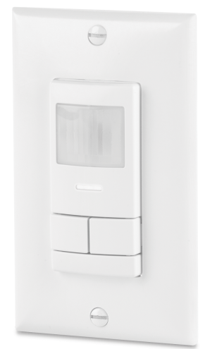
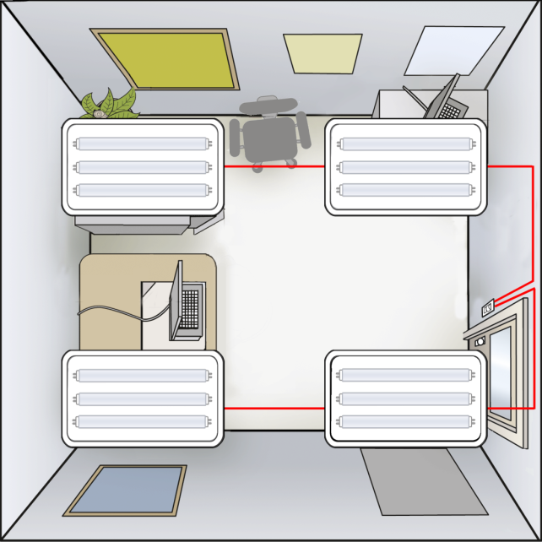
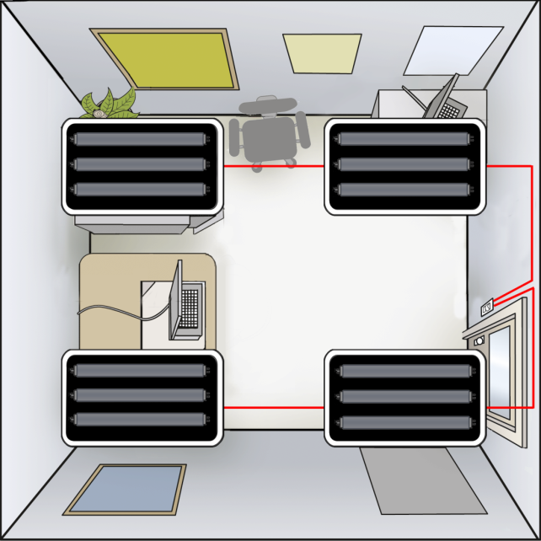
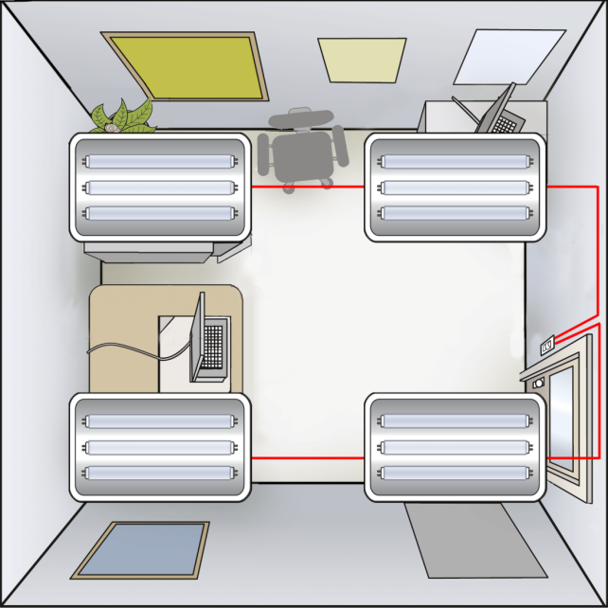
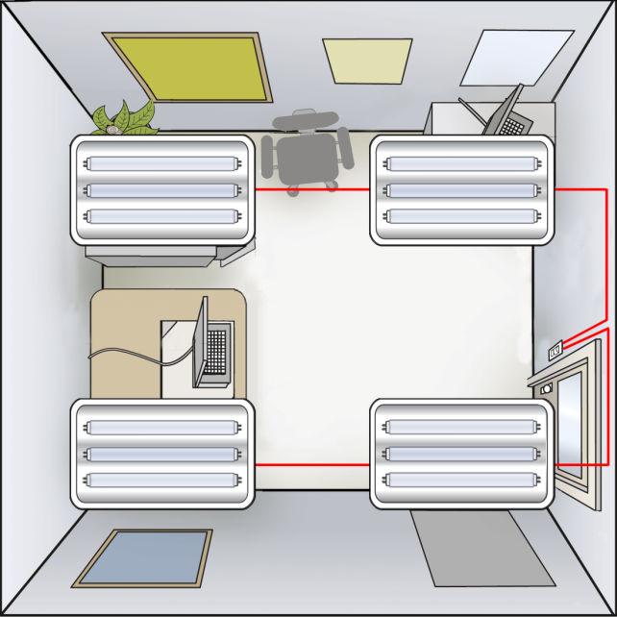
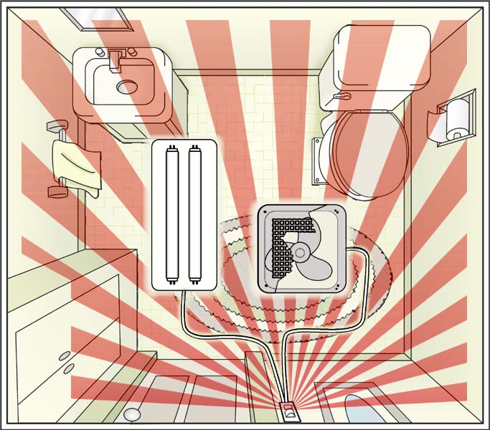
Applications: Wall Switch Sensors
2-Pole (i.e. Dual Relay) Wall Switch Sensors
Independent control of two circuits
Perfect for bi-level applications
Pole 1: Automatic On Pole 2: Manual On
Separate time delays / pole (e.g. 10 min for lights, 20 min for fan)
Control different load sizes w/ same unit (e.g. 120 VAC fan & 277 VAC light)
Private Office wired or Bi-Level
Restroom w/ Light & Fan
WSX 2P
WSX PDT 2P

Slide 7
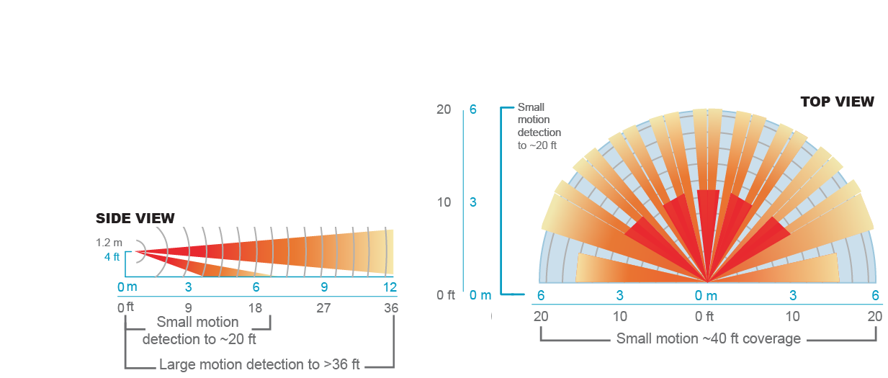
Coverage of the WSX Family
Detection
Small motion (e.g., hand movements) detection up to 20 ft (6.10 m), ~625 ft2
Large motion (e.g., walking) detection greater than 36 ft (10.97 m), ~2025 ft2
Wall-to-Wall coverage
Passive Dual Technology (Microphonics) provides overlapping detection of human activity over the complete PIR coverage area. Advanced filtering is utilized to prevent non-occupant noises from keeping the lights on.

Slide 8
Product Features of the WSX / WSD Family
Wiring / Installation
Convertible neutral / non-neutral wiring - makes meeting NEC 2011 and other jobsite requirements quick and easy (patent pending)
No neutral required / no minimum load
- even for 2-Pole Dual Tech with a night light!
Reversible line & load connections - impossible to wire backwards (patented)
Integrated grounding/mounting strap
All-digital push-button programming - adjust settings w/o removing wall plate
No PIR sensitivity adjustments
Contractor favorite
Load Ratings / Pole
800 W @ 120 VAC
1200 W @ 277 VAC
1500 W @ 347 VAC
¼ HP Motor Load

Slide 9
Question: What’s new about NEC2011 and could it affect my project?

Slide 10
Answer…
The Facts about NEC 2011 404.2(C):
The new NEC 2011 code requires a neutral conductor to be installed in all new construction switch boxes.
Stated intent is to prevent contractors from improperly using ground connection to power devices that have greater than 0.5 mA leakage to ground
Contractors are not required to use the neutral if the device they are installing is UL listed to draw less than 0.5 mA leakage to ground.
- this includes Wall Switch Occupancy Sensors like the WSX
Also not required for retrofit construction except in cases where bringing up to current code is required
Some jurisdictions that have adopted NEC 2011 and specifiers are interpreting this new section to require all Wall Switch Occupancy sensors to have and use a neutral (e.g. City of Houston, Birmingham, etc.)
The Reality:

Slide 11
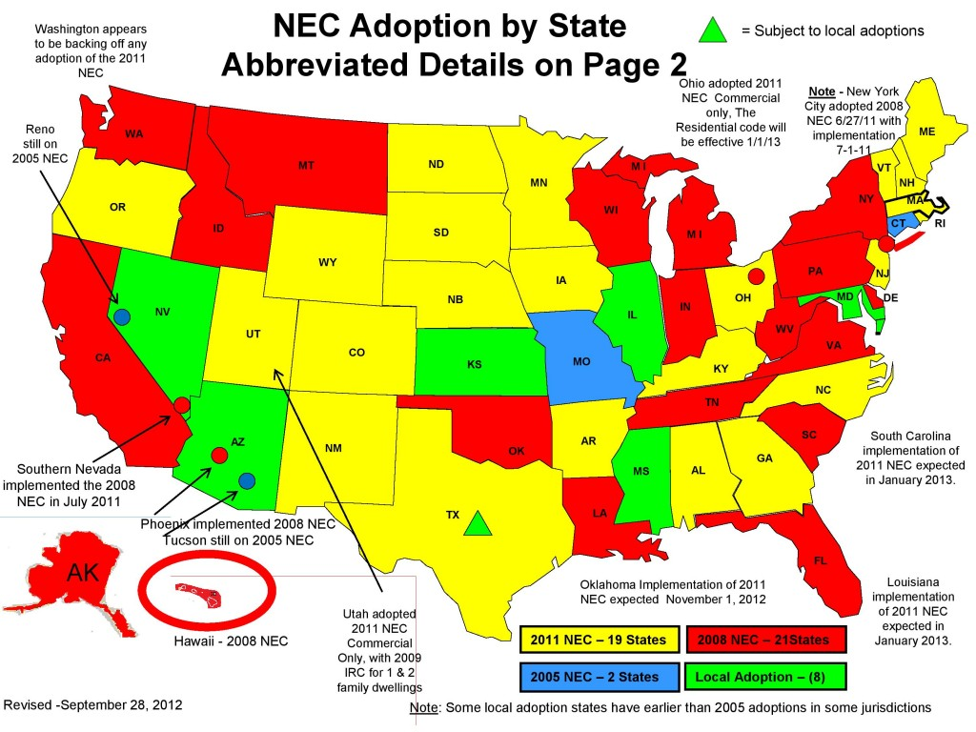

Slide 12
Answer…Patent Pending Convertible Neutral / No Neutral Wiring
What is it:
WSX and WSD Family Wall Switch sensors accommodates wiring to either a ground or a neutral connection.
- Example model number: WSX PDT WH
Unit comes preconfigured to power over ground, however if code requires neutral to be used the unit can be quickly and easily converted to power over neutral (see next slide for details)
Advantage:
Enables contractors and distributors to stock just one device regardless of neutral or non-neutral code requirements.

Slide 13
Answer…Patent Pending Convertible Neutral / No Neutral Wiring
Patent Pending WSX NGX
Conversion from No Neutral to Neutral Configuration…
…..change within seconds!
STEP 1: Remove the yellow label
STEP 2: Loosen the screws and remove the metal link
STEP 3: Connect the Ground to the green screw & neutral to the Silver Screw

Slide 14
Answer…Patent Pending Convertible Neutral / No Neutral Wiring
Market Advantages:
Patent Pending WSX NGX
Distributor
Stock one unit
No need to ask the question
No risk of returned material
Reasonably price adder
Engineer
Spec standardization across jurisdictions
Never a question based on inspector interpretation (today or in future)
Still able to have 3 name spec with competitors’ neutral only units
Control circuit connects to neutral with no leakage to ground
Contractor
One unit for all installations
Never a question based on inspector interpretation (today or in future)
No hassle of returning material or change-outs

Slide 15
Question: How do these sensors work without a neutral connection… …and why should I care?

Slide 16
Answer…
Option 1: Leaking Power over Ground Connection
NEC and UL allow very low current to be pulled over ground connection (GFI’s trip ~4-6 mA)
Sensor Switch products are engineered to draw
ultra-low current (< 0.5 mA)
Since Microphonics is a completely passive technology it also requires very low current to function
Sensors using Ultrasonic draw more current than allowed, thus requirement for neutral wire
Important in retrofit applications as existing switch legs often are only two wires (hot and load) with no neutral
Option 2: Leaking Power to Load
Requires a minimum load
Damages electronic fluorescents lamps (especially compacts) as current makes lamps attempt to start
Rarely seen in commercial occupancy sensors, still seen in timer switches

Slide 17
Sequence of Operation
Auto On / Auto Off
Auto On / Manual Off
Manual On / Auto Off

Slide 18
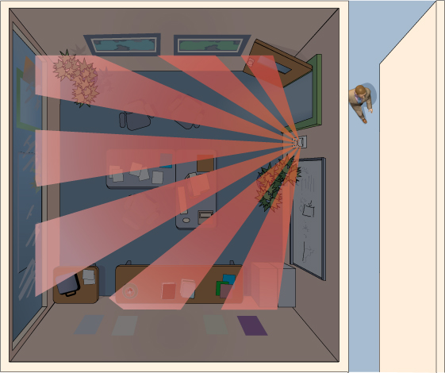
Sequence of Operation for the WSX: Auto On / Auto Off
Sequence of Operation
Lights are held off awaiting initial occupancy

Slide 19
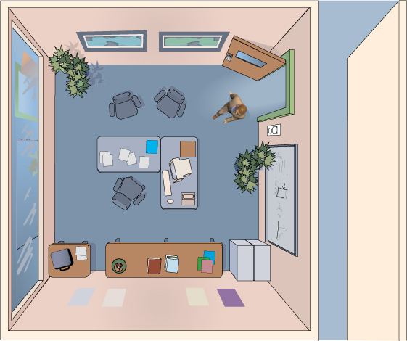
Sequence of Operation for the WSX: Auto On / Auto Off
Sequence of Operation
Lights are held off awaiting initial occupancy
Occupant enters space, light turn on

Slide 20
Sequence of Operation for the WSX: Auto On / Auto Off
Sequence of Operation
Lights are held off awaiting initial occupancy
Occupant enters space, light turn on
Occupant leaves space and time delay expires

Slide 21
Sequence of Operation for the WSX: Auto On / Auto Off
Sequence of Operation
Lights are held off awaiting initial occupancy
Occupant enters space, light turn on
Occupant leaves space and time delay expires
Lights turn off and sensor is immediately back in original auto-on state

Slide 22
Sequence of Operation
Auto On / Auto Off
Auto On / Manual Off
Manual On / Auto Off

Slide 23
Sequence of Operation for the WSX: Auto On / Manual Off
Scenario 1:
Pressing the switch turns the lights off

Slide 24
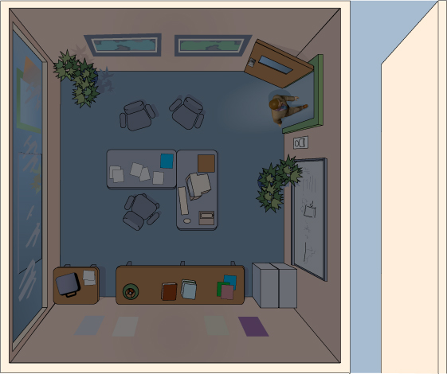
Sequence of Operation for the WSX: Auto On / Manual Off
Scenario 1:
Pressing the switch turns the lights off
Occupancy detection disabled for 10 secs (Predictive Exit Time Setting) while person leaves the room

Slide 25
Sequence of Operation for the WSX: Auto On / Manual Off
Scenario 1:
Pressing the switch turns the lights off
Occupancy detection disabled for 10 secs (Predictive Exit Time Setting) while person leaves the room
PIR detector reactivates for 30 secs (Predictive Grace Time setting) to scan room.

Slide 26
Sequence of Operation for the WSX: Auto On / Manual Off
Scenario 1:
Pressing the switch turns the lights off
Occupancy detection disabled for 10 secs (Predictive Exit Time Setting) while person leaves the room
PIR detector reactivates for 30 secs (Predictive Grace Time setting) to scan room.
If no occupancy is detected, the sensor reverts to Auto-on immediately & activates the lights the next time someone enters the room.

Slide 27
Sequence of Operation for the WSX: Auto On / Manual Off
Scenario 1:
Pressing the switch turns the lights off
Occupancy detection disabled for 10 secs (Predictive Exit Time Setting) while person leaves the room
PIR detector reactivates for 30 secs (Predictive Grace Time setting) to scan room.
If no occupancy is detected, the sensor reverts to Auto-on immediately & activates the lights the next time someone enters the room.

Slide 28
Question: What happens if I turn the lights off using the switch and then remain in the room for awhile?
Sequence of Operation for the WSX: Auto On / Manual Off

Slide 29
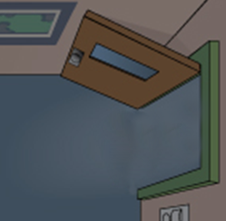
Sequence of Operation for the WSX: Auto On / Manual Off (Predictive Mode with Expiration)
Scenario 2:
Person turns off lights and remains in room.

Slide 30
Sequence of Operation for the WSX: Auto On / Manual Off (Predictive Mode with Expiration)
Scenario 2:
Person turns off lights and remains in room.
Sensor detects occupant & disables Auto-On mode, keeping lights off.

Slide 31
Sequence of Operation for the WSX: Auto On / Manual Off (Predictive Mode with Expiration)
Scenario 3:
Person turns off lights and remains in room.
Sensor detects occupant & disables Auto-On mode, keeping lights off.
Sensor continues monitoring the room, detecting occupancy.

Slide 32
Sequence of Operation for the WSX: Auto On / Manual Off (Predictive Mode with Expiration)
Scenario 3:
Person turns off lights and remains in room.
Sensor detects occupant & disables Auto-On mode, keeping lights off.
Sensor continues monitoring the room, detecting occupancy.
Person later exits room.

Slide 33
Sequence of Operation for the WSX: Auto On / Manual Off (Predictive Mode with Expiration)
Scenario 3:
Person turns off lights and remains in room.
Sensor detects occupant & disables Auto-On mode, keeping lights off.
Sensor continues monitoring the room, detecting occupancy.
Person later exits room.
After sensor detects vacancy for a time equal to the occupancy time delay, the switch reverts to Auto-On.

Slide 34
Sequence of Operation for the WSX: Auto On / Manual Off (Predictive Mode with Expiration)
Scenario 3:
Person turns off lights and remains in room.
Sensor detects occupant & disables Auto-On mode, keeping lights off.
Sensor continues monitoring the room, detecting occupancy.
Person later exits room.
After sensor detects vacancy for a time equal to the occupancy time delay, the switch reverts to Auto-On
Lights turn on the next time someone enters.

Slide 35
Sequence of Operation
Auto On / Auto Off
Auto On / Manual Off
Manual On / Auto Off

Slide 36
Question: When should Manual On operation be used?

Slide 37
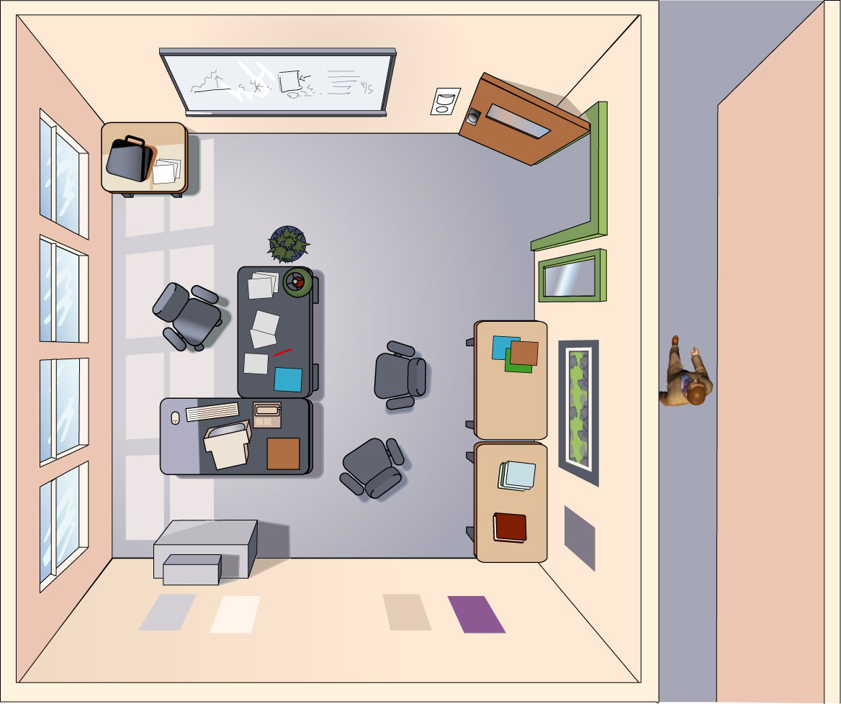
Other Operational Modes of the WSX: Manual On
Application
Required by some energy codes
Also useful if sensor can see out of the room

Slide 38
Other Operational Modes of the WSX: Manual On
Example
Window in wall next to door
Sensor mounted on adjacent wall

Slide 39
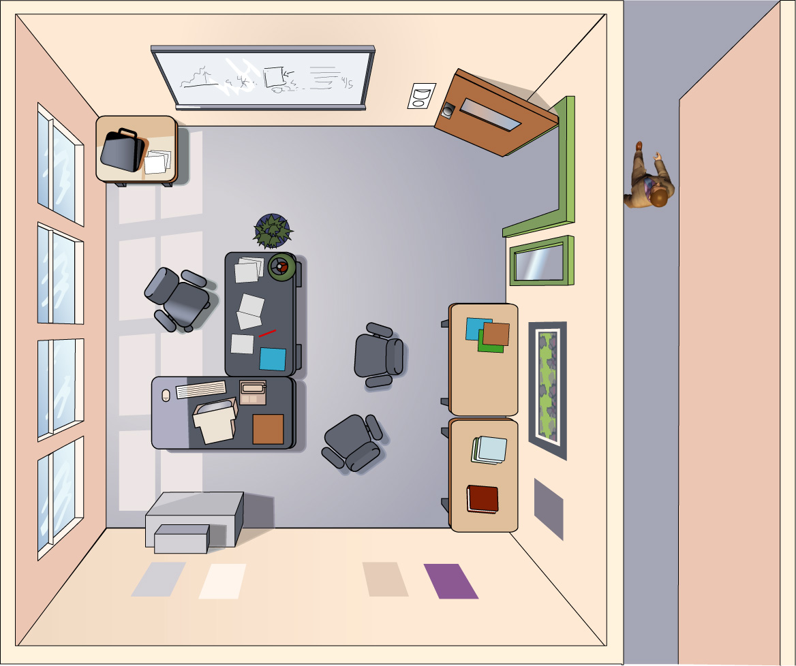
Other Operational Modes of the WSX: Manual On
Example
Window in wall next to door
Sensor mounted on adjacent wall
Person walks by door

Slide 40
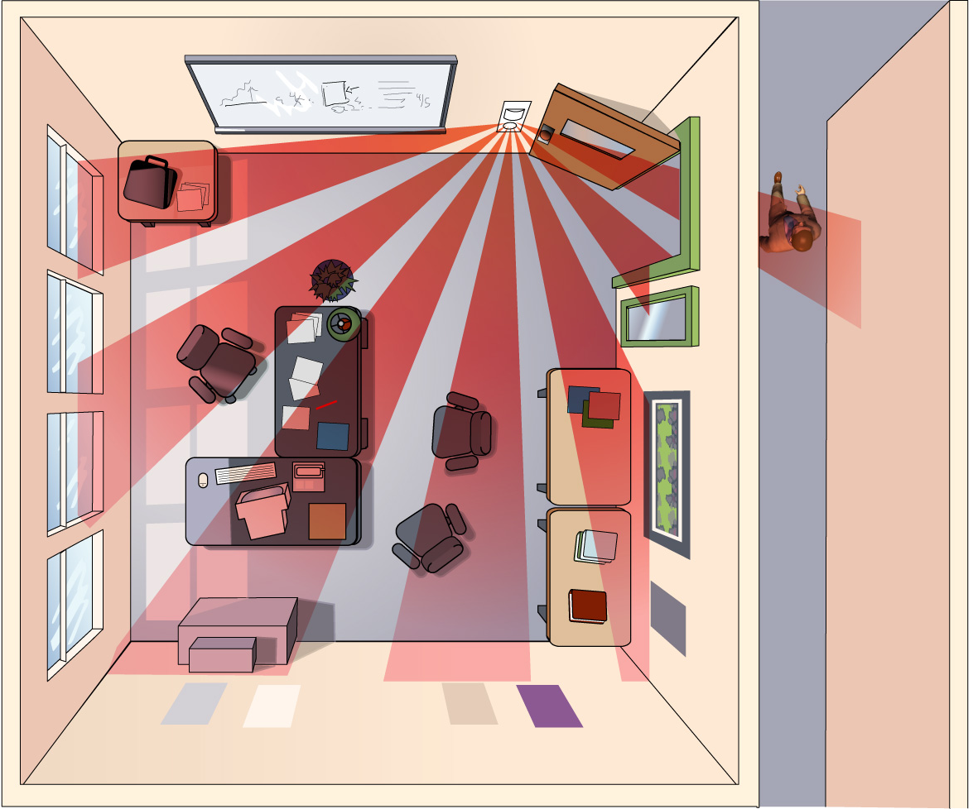
Other Operational Modes of the WSX: Manual On
Example
Window in wall next to door
Sensor mounted on adjacent wall
Person walks by door
Sensors see out the door and turns on lights automatically

Slide 41
Other Operational Modes of the WSX: Manual On
Example
Manual On is the best solution!

Slide 42
Other Operational Modes of the WSX: Manual On
Example
Manual On is the best solution!
Default operation of WSX SA &
WSX PDT SA
Available via setting on standard units

Slide 43
Question: What is a Vacancy Sensor?

Slide 44
Commonly used (& misused) terms…
Occupant Sensor
The term occupant sensor applies to a device that controls indoor lighting systems.
Motion Sensor
When the device is used to control outdoor lighting systems, it is termed a motion sensor.
Types of Occupant Sensors
Occupancy Sensor: Auto On, Auto Off (e.g. WSX)
Manual On Occupancy Sensor: Manual On, Auto Off (e.g. WSX SA)
Device can be converted to Auto On/Auto Off)
Vacancy Sensor: Manual On, Auto Off (e.g. WSX VA)
Device shall not be capable of being converted to an Auto On functionality. Typically energy codes (T24) only require Vacancy sensors in residential applications.

Slide 45
Question: Can sensors see through glass?

Slide 46
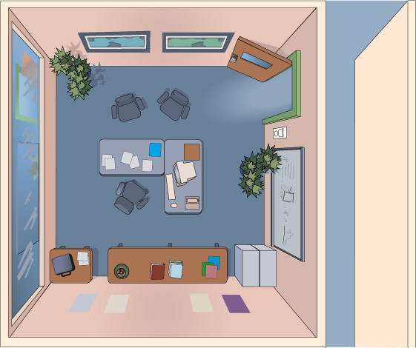
Other Operational Modes of the WSX:
Reduced Turn On
Problem
PIR cannot see through glass
However, PIR
can see reflections

Slide 47
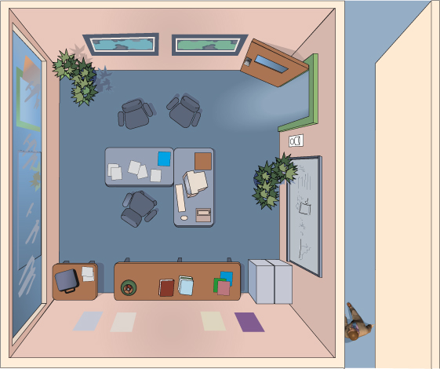
Other Operational Modes of the WSX:
Reduced Turn On
Problem
PIR cannot see through glass
However, PIR
can see reflections
Passerby enters hallway

Slide 48
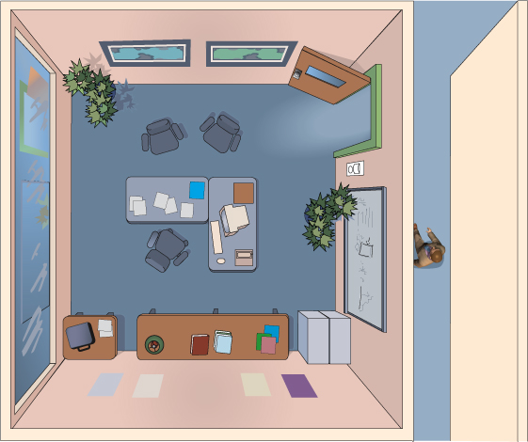
Other Operational Modes of the WSX:
Reduced Turn On
Problem
PIR cannot see through glass
However, PIR
can see reflections
Passerby enters hallway

Slide 49
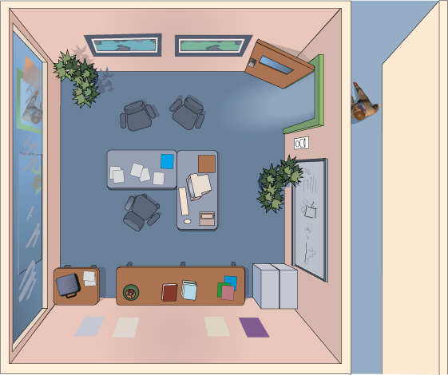
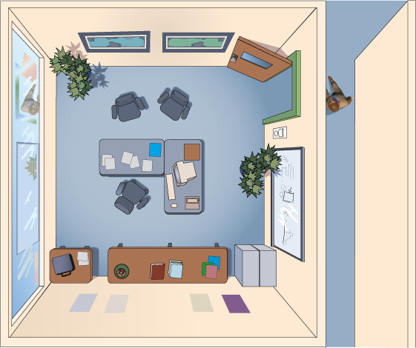
Other Operational Modes of the WSX:
Reduced Turn On
Problem
PIR cannot see through glass
However, PIR
can see reflections
Passerby enters hallway
Reflection of person shows in window

Slide 50
Other Operational Modes of the WSX:
Reduced Turn On
Problem
PIR cannot see through glass
However, PIR
can see reflections
Passerby enters hallway
Reflection of person shows in window

Slide 51
Other Operational Modes of the WSX:
Reduced Turn On
Problem
PIR cannot see through glass
However, PIR
can see reflections
Passerby enters hallway
Reflection of person shows in window

Slide 52
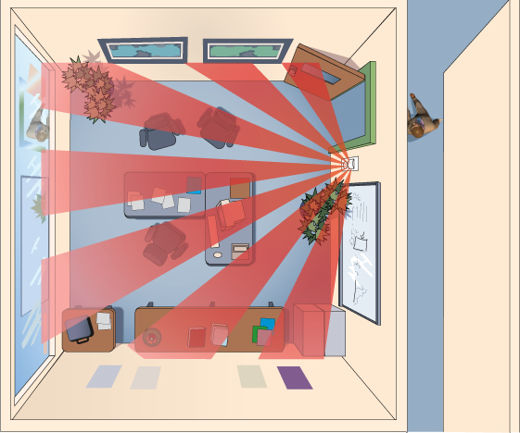
Other Operational Modes of the WSX:
Reduced Turn On
Problem
PIR cannot see through glass
However, PIR
can see reflections
Passerby enters hallway
Reflection of person shows in window
Lights turn on

Slide 53
Solution: Reduced Turn On Mode
Reflective PIR signals of an occupant is much weaker than direct view PIR signals
PIR sensor sensitivity is initially reduced so that reflection does not trigger switch
PIR sensor sensitivity returns to full level after light are turned on

Slide 54
Other Operational Modes of the WSX:
Reduced Turn On
Solution
Reflection of person shows in window

Slide 55
Other Operational Modes of the WSX:
Reduced Turn On
Solution
Reflection of person shows in window
In “Reduced Turn On” mode, signal is too weak to trigger

Slide 56
Other Operational Modes of the WSX:
Reduced Turn On
Solution
Reflection of person shows in window
In “Reduced Turn On” mode, signal is too weak to trigger
Lights Stay Off!

Slide 57
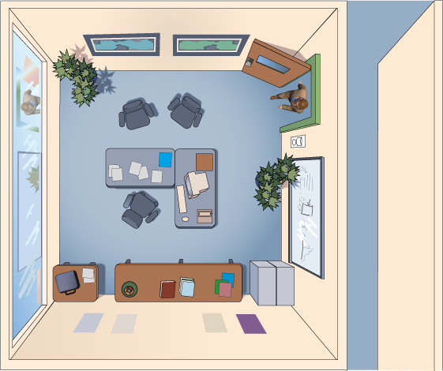
Other Operational Modes of the WSX:
Reduced Turn On
Solution
Occupant enters creating large PIR signal

Slide 58
Other Operational Modes of the WSX:
Reduced Turn On
Solution
Occupant enters creating large PIR signal

Slide 59
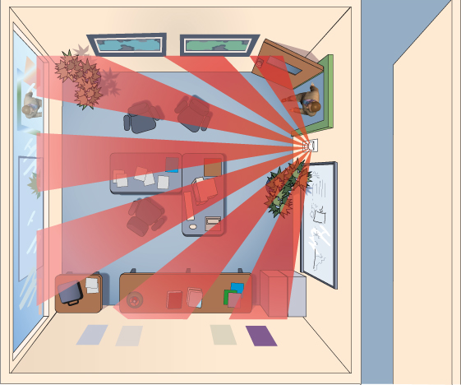
Other Operational Modes of the WSX:
Reduced Turn On
Solution
Occupant enters creating large PIR signal
Sensor detects and turns on

Slide 60
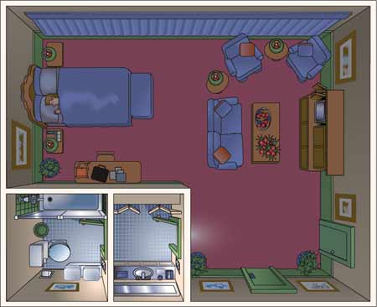
Additional Wall Switch Solutions: WSX NL
Applications
Ideal for Hotel or Hospital Bathrooms
Many people leave a light on all night
Provides enough light for 2 AM trip to bathroom

Slide 61
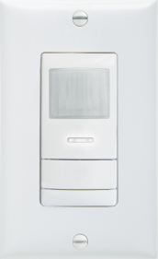
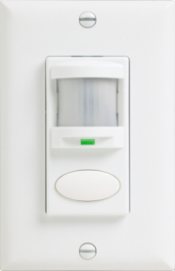
Comparison of Wall Sensor Families
 | WSX | WSD | SSD
Detection | PIR or Dual Tech | PIR or Dual Tech | PIR
# of Relays | 1 or 2 | 1 or 2 | 1
Wiring | Convertible Neutral / No Neutral | Convertible Neutral / No Neutral | No Neutral (Ground only)
Voltage | 120/277 or 347 VAC | 120/277 or 347 VAC | 120 VAC
Photocell | Standard | Standard | Not available
Night Light Option | ✓ | - | -
Vandal Lens | Standard | - | -
Wall Plate Included | ✓ | ✓ | -
Notes:
61

Slide 62
WSX Family Ordering Logic

Slide 63
WSX Family Ordering Logic (cont.)

Slide 64
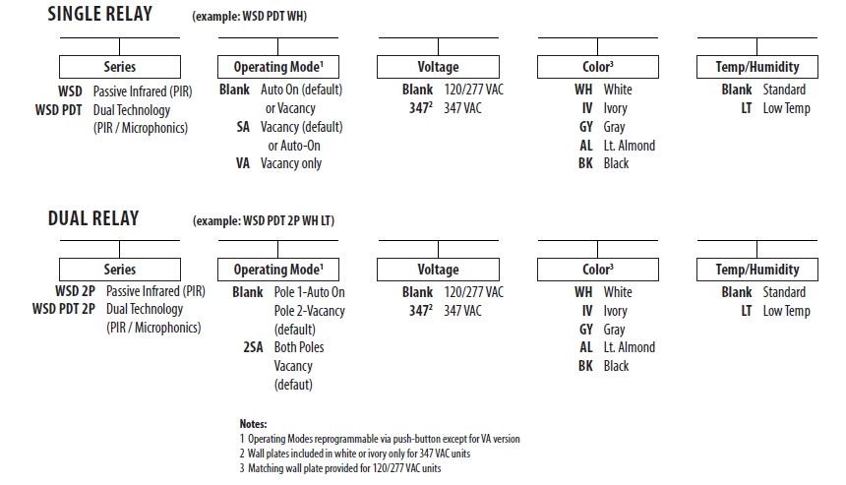
WSD Family Ordering Logic

Slide 65
SSD Family Ordering Logic
Series
Operating Mode
Voltage
Color
SSD 120
Blank = Auto-On (default) or Vacancy
SA = Vacancy (default) or Auto-On
VA = Vacancy Only
WH = White
IV = Ivory

Slide 66
Question: How do you adjust the time delay?

Slide 67
Answer…
Push Button Programming :
All WSXs have a microprocessor brain that enables sophisticated operation
All operational parameters are stored internally in tables called “Function Codes”
Parameters can be changed via a push-button sequence
Several functions are intended for customer usage, additional functions are utilized by manufacturing and/or tech support
Example Functions:
Time Delay Disable Switch
Operational Mode Photocell Set-Point

Slide 68
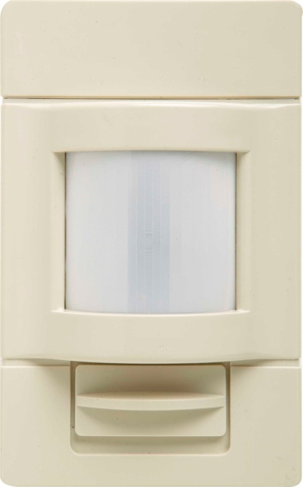
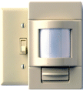
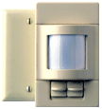
Additional Wall Switch Solutions: LWS(H)
Large Area Wall Switch Sensor
Surface mounted unit
Increased focal length allows for small motion
detection to 40 ft
No neutral required / no minimum load
Single pole and 2-pole versions
PIR/Dual Tech versions
Switches 13 Amps / pole
LWS versions mounts between 3 and 4 ft
LWSH versions has lens that accommodates mounting between 4 and 7 ft
Available in Ivory and White
Accessory Plates

Slide 69
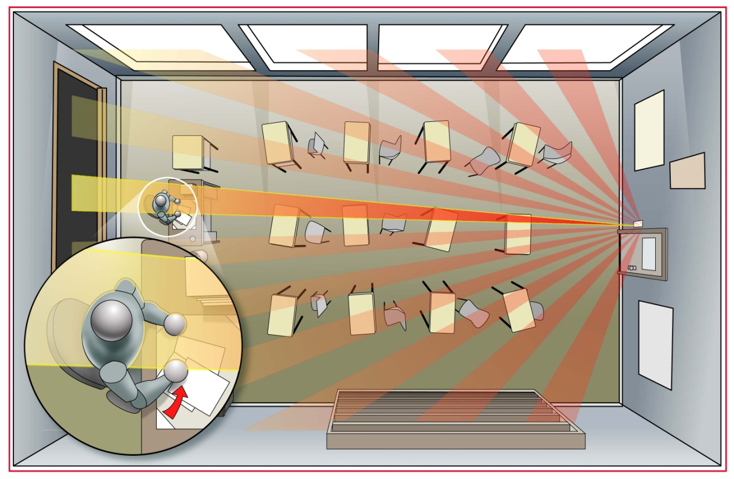
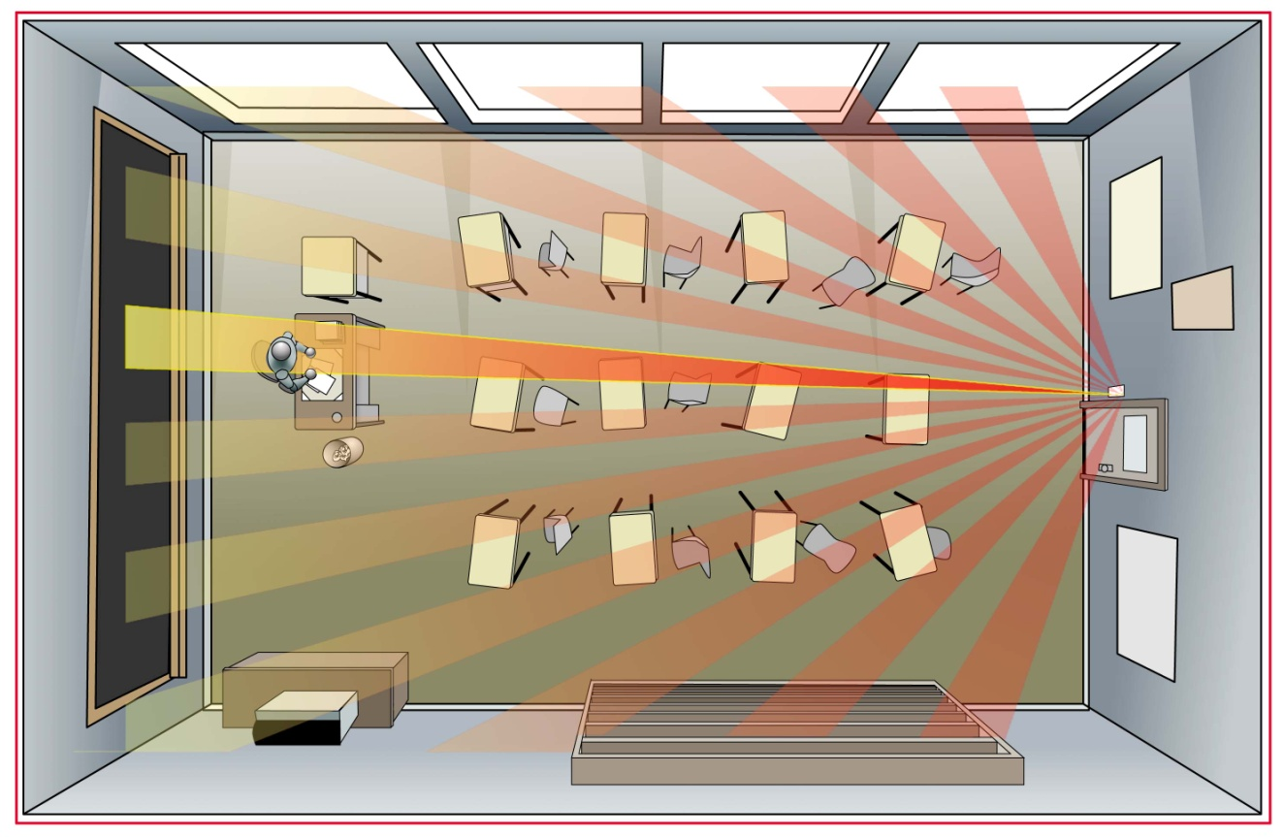
Additional Wall Switch Solutions: LWS(H)
Applications
Ideal for retrofitting classrooms
Small motion detection at 40 ft
© 2013 Sensor Switch

